Slide 1
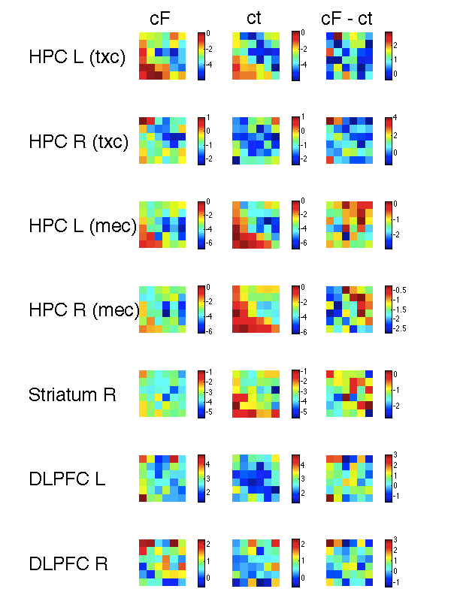
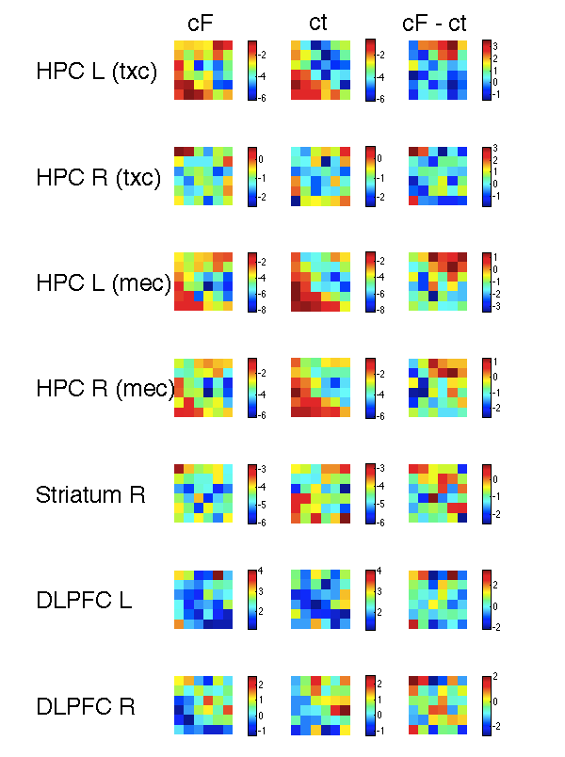
c13g Choice ROIs t statistic (non mean centred)
t1_1 Trialtype
t2_1_TrialtypeNc

Slide 2
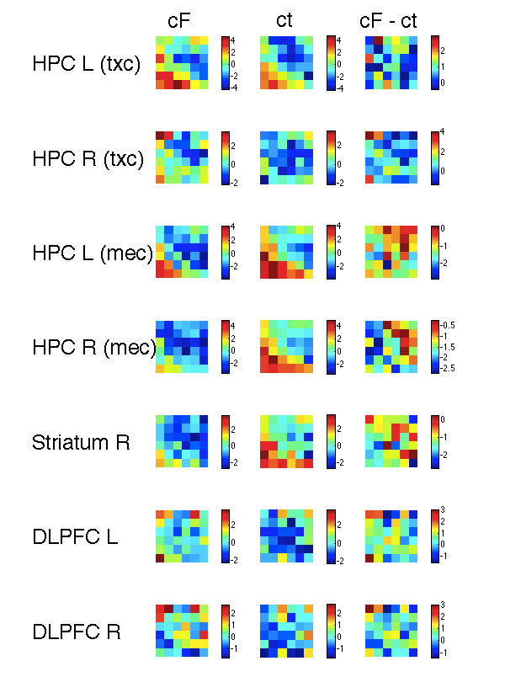
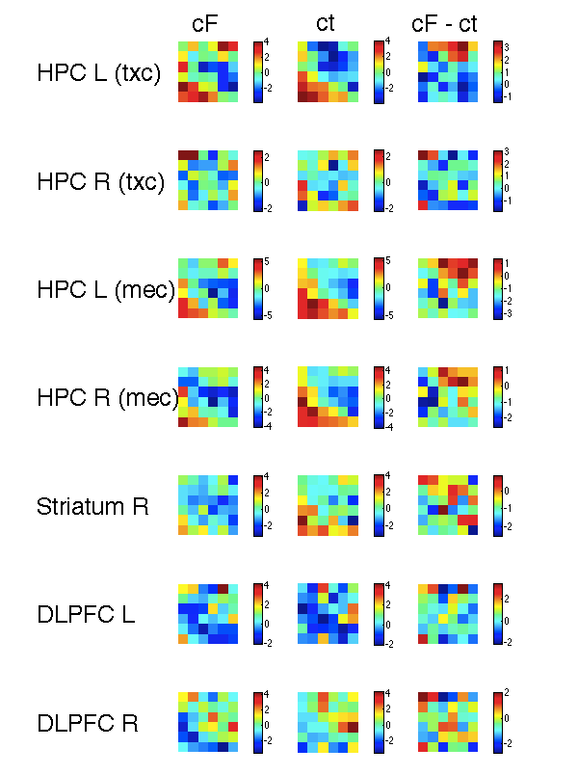
c13g Choice ROIs t statistic (mean centred)
t1_1 Trialtype
t2_1_TrialtypeNc

Slide 3
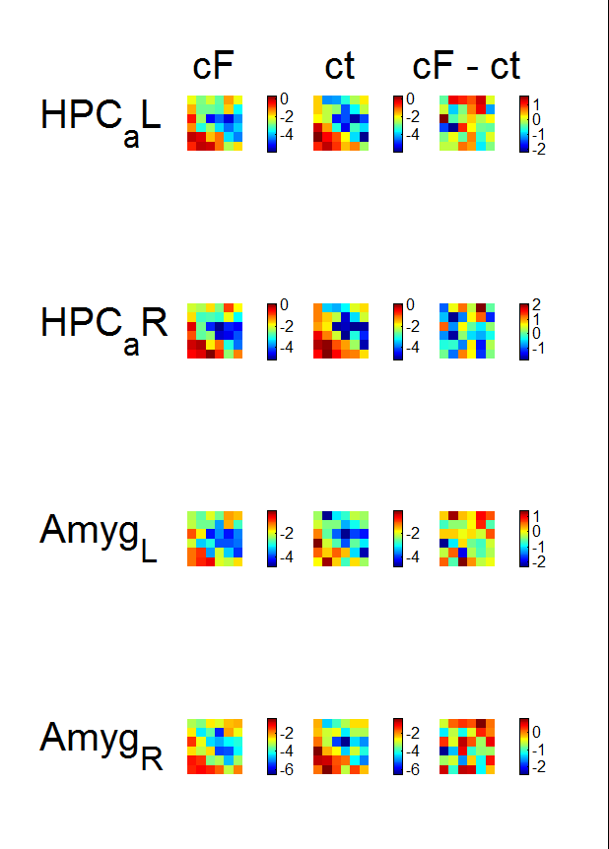
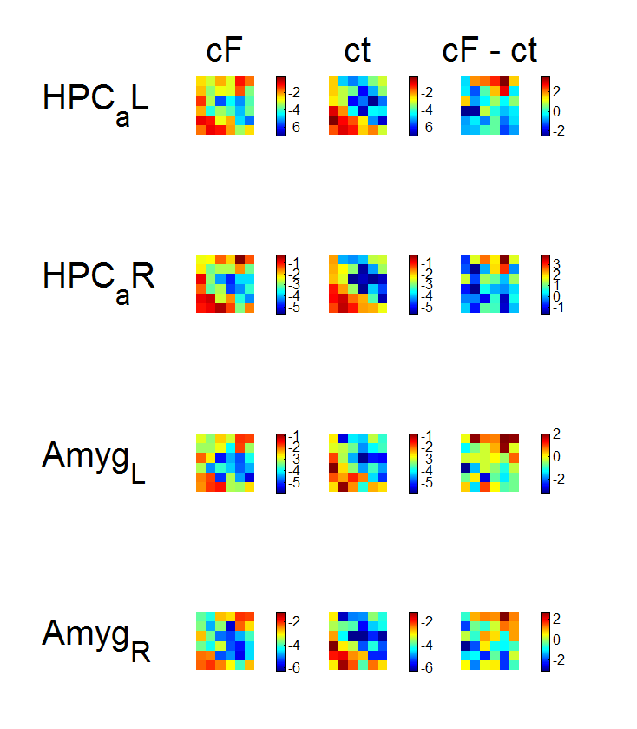
Anat ROIs t statistic (non mean centred)
t1_1 Trialtype
t2_1_TrialtypeNc

Slide 4
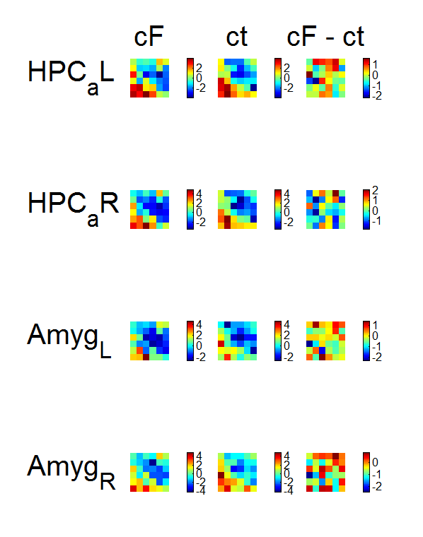
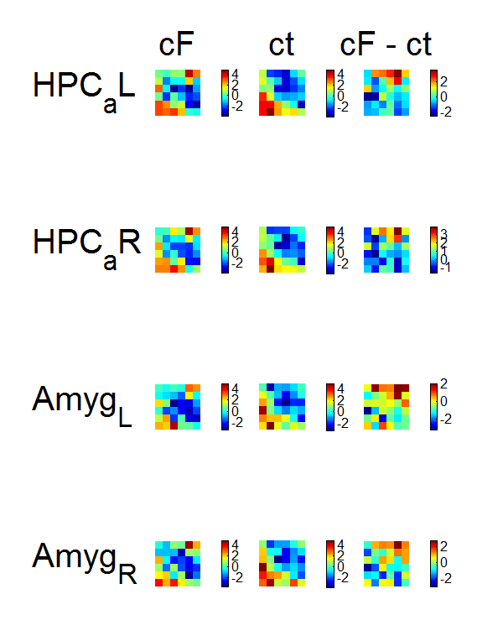
Anat ROIs t statistic (mean centred)
t1_1 Trialtype
t2_1_TrialtypeNc

